Slide 1
Jersey Advisory & Conciliation Service
Employment Legislation
All materials contained in this presentation are protected by copyright laws, and may not be reproduced, republished, distributed, displayed, or otherwise used in any manner without the express prior written permission of JACS.

Slide 2
Corvid-19/Coronavirus & the Workplace
Updated 15 March 2020

Slide 3
Remember…
Gov.je is the go to place for all local updates and generic advice.

Slide 4
Dr Ivan Muscat …
… “Our aim is to be open with islanders and ensure that we give the best possible treatment and care to our patients whilst protecting their confidentiality.
… “The best thing people can do to help stop the spread of coronavirus is to be scrupulous about hand, surface and respiratory hygiene. Wash your hands frequently. Use tissues to cough or sneeze into and throw them away as soon as you have used them. Keep the surfaces you work on and touch as clean as you can. Those messages will not change.”

Slide 5
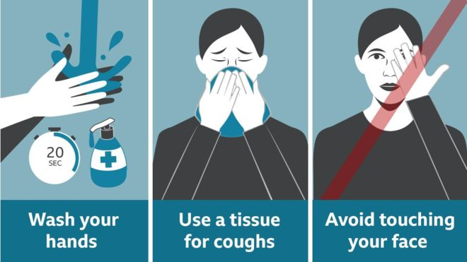
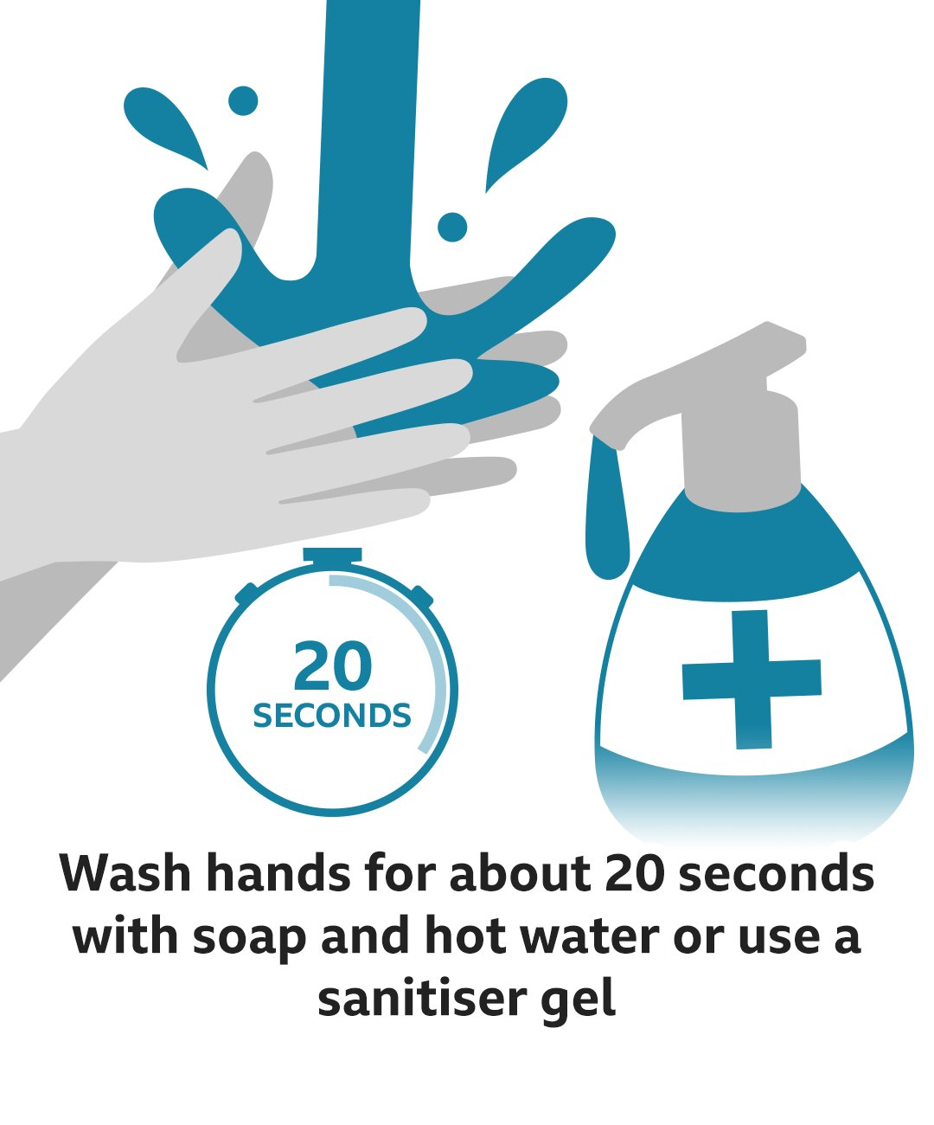
Public health experts have been giving out lots of advice to try to stop the spread of the virus.
How do I protect myself?
VIDEO: The 20-second hand wash
What are the symptoms?
What should I do if I feel unwell?

Slide 6
Limiting the Spread
The advice around this virus as been about handwashing for at least 20 seconds with soap and hot water (whilst the use of alcohol hand sanitizer is not necessary if proper washing facilities are available it does support infection control);
Language barriers – print out the ‘posters’ available online or go onto www.gov.je where they have advice in Portuguese and Polish;
Wipe down surfaces – anti-bacterial is not going to have an impact as this is a virus (but it will prevent any additional bacterial infections that may be around) and therefore alcohol based cleaning products should be used;

Slide 7
More…
Stop (or limit) hot-desking; If this is not possible then keyboards, and ‘phones should be wiped regularly with alcohol wipes;
Have tissues available and bins;
Re-consider any business travel arrangements – are they necessary?
Generic masks are not necessary and likely to afford limited protection by preventing individuals touching their mouth;

Slide 8
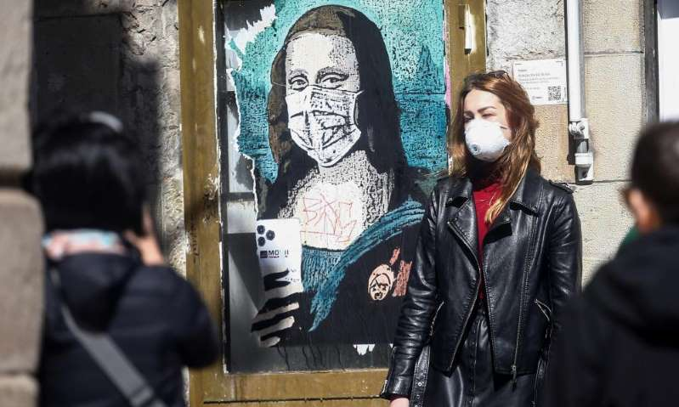

Slide 9
Masks …
Eric Toner, of the Johns Hopkins University Center for Health Security,
‘ there’s ‘little harm’ in wearing face masks. But he added: ‘It’s not likely to be very effective in preventing it.’

Slide 10
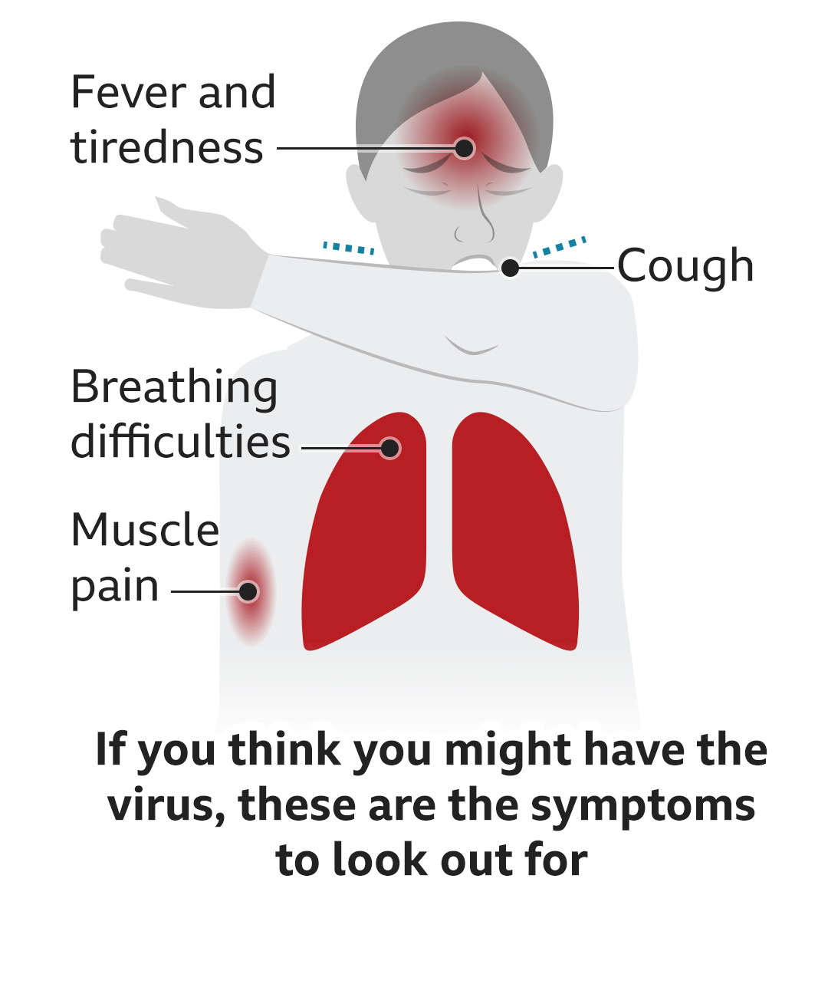
Symptoms

Slide 11
What to do if someone becomes ill at work.
Other people need to be at least 2 metres away from the affected individual;
The affected individual should avoid touching anything – if this does happen then ensure the area is cleaned thoroughly;
If possible open a window.

Slide 12
More …
If the employee needs the bathroom – ensure others do not use it until it has been thoroughly cleaned;
Double-bag any rubbish that may contain infected tissues etc and place in a safe place until the test results of the virus are known;
Call the government helpline 445566 or call 999 if the employee is seriously unwell, and the advice followed – they should not just turn up at the hospital or any health centre/GP.

Slide 13
Cleaning Offices (from Gov.je)
Once symptomatic, all surfaces that the person has come into contact with must be cleaned including:
all surfaces and objects which are visibly contaminated with body fluids
all potentially contaminated high-contact areas such as toilets, door handles, telephones
Public areas where someone with the infection has passed through and spent minimal time in (such as corridors) but which are not visibly contaminated with body fluids do not need to be specially cleaned and disinfected.
If a person becomes ill in a shared space, it should be cleaned using disposable cloths and household detergents, according to current recommended workplace legislation and practice.

Slide 14
Other Employees …
If there is a suspected case in the workplace, there are no restrictions or any special control measures until the test results have been completed;
The majority of individuals tested are negative, therefore employees do not need to be sent home or the workplace;

Slide 15
However …
Employees are likely to be worried and will need reassurance;
Consider if you have any particularly vulnerable employees those with a chronic respiratory illness or weakened immune system;
Also any employees that are pregnant.

Slide 16
Update 14 March – Over 65s Social Distancing (gov.je)
Social distancing means limiting unnecessary contact with people outside of your household unless absolutely essential
We are currently recommending this to over 65s who are not essential for the running of the Island's services should they wish to continue carrying out their roles.
For those 65 year olds who do chose to adhere to social distancing, when not in the home, they should keep to a distance of 1 metre (3 feet) from others. There may be, therefore, the need to avoid large public gatherings where this is not possible.
If you work, or are not at home, you should avoid using public transport during peak hours unless essential.

Slide 17
More on Social Distancing
For employers JACS advice would be to:
Apply the same measures for those who have been affected by the 14 March update as you would for those who are self-isolating;
If employee can work from home in some way then they can be encouraged to do this;
Ask employees to ‘check in’ with you (daily or every other day) via email or telephone to ensure they are well.

Slide 18
Self Isolation
Employer should be notified as soon as possible self-isolation is necessary;
Remember unlike the UK, Jersey has no statutory sick pay, therefore any payment made by an employer is done so under the terms of employment.
However those who do self isolate can claim Short Term Incapacity Allowance (STIA) for 2 weeks, by contacting Customer and Local Services (444444 or via email to the health-zone on www.gov.je.
Proof of recent travel to an affected (listed) country will be required.

Slide 19
Affected Countries
Remember that this is an evolving situation, therefore it is important to check the updated list on www.gov.je and/or www.WHO.int (the World Health Organisation); and/or Foreign Office for travel advice.

Slide 20
Travel advice from Chief Minister 14 March 2020
… ‘And, from today, we’re asking that Islanders only undertake essential travel into and out of the Island.
You can still travel for medical and compassionate purposes. And key workers required to keep our essential services running can also continue travelling.’ …

Slide 21
More on Self-Isolation
If any employees need to self-isolate remember to keep in touch with them and for those you know who may live on their own check that they have sufficient provisions and food for the 2 weeks.

Slide 22
Business Continuity
Do you have a workable business continuity plan already in place?
Think about any operational requirements in the short/medium and longer term;
If employees are not at work, do your contracts allow for business critical activities to continue re flexibility or maybe consider shift systems.
Can you offer overtime payments/time off in lieu to ensure that it is ‘business as usual’?

Slide 23
More …
Gov.je have released a Business Continuity checklist which you can access here.

Slide 24
Working From Home
Do you have a homeworking policy – if not it may be worth considering developing one now?
Can you enable employees to work from home during any period of office closure/self-isolation?
If this is possible then remember that the employee cannot claim STIA at the same time.
Encourage employees to keep in touch with the employer and colleagues during any such period.

Slide 25
Closing the Workplace
If an employer takes the decision to close the workplace then employees will need to be paid for this – unless the right is reserved under contract for a short-term cessation of work;
Employees should be advised:
of how long the closure will be in place;
information around access;
working from home (if available);
who is the point of contact during the closure;
any rules around this eg not leaving the Island etc.

Slide 26
Remember …
To reassure employees that all is being done to enable the business to re-open as soon as possible (eg a deep clean of the site)

Slide 27
Schools Closure
There is no statutory provisions in place for employees to take time off if schools close (or if care is needed to be given to another person). Therefore employers should:
Be as flexible as possible – home working, unpaid leave, temporary changes to working hours/venues, working back hours at a later stage;
Understand that this is not something that individuals will have any control over;
Using annual leave to cover such a period.

Slide 28
Salary and Benefits etc
Contractual sick pay:
Ensure employees are reminded of the absence reporting policy to enable any payments due under contract to be met;
All benefits will continue to apply during any period of absence including self-isolation;
Remember to be flexible in respect of receiving any medical certificates if your policy gives a timeframe as employees may not able to get this to you.

Slide 29
However …
Important to remember that if employees are not going to receive any salary payments they may decide to attend the workplace (despite being unwell) and take steps to cover their symptoms.

Slide 30
Zero Hour Contracts
If employees are working under zero hour contracts (in the true ‘as and when’ sense), there will be no obligation to pay them unless it is covered in their contract;

Slide 31
Things to Do Now …
Ensure you have up—to-date contact details and addresses for all your employees;
Remind employees of your absence reporting policy;
Ensure you have business continuity plans eg working from home or a clean venue;
Reassure employees of the steps being taken to protect them in the workplace;
Ensure that no one is discriminated against under any of the protected characteristics (bear in mind race and disability in particular).

Slide 32
More …
If you have any employees who may be at a higher risk than others, ensure you know who they are – remember employees do not have to provide this information to you and the usual Data Protection rules will apply;
Ensure employees are aware that they can advise of any symptoms and or if they are struggling with the current situation.
If there is a downturn in business do you have a temporary lay off clause set out in the contracts?

